Slide 1

Data Science with Python
Mehmet Ali Varol
Senior Data Scientist
mehmetali.varol@linktera.com.tr
20.01.2021

Slide 2
Topics
Topics to be covered in the workshop:
Section 1:
Data EveryWhere!
The 3V’s of Big Data
DIKW Hierarchy
Structured Data vs Unstructured Data
Data Preprocessing
CRISP-DM
Visualization
Model Basics & Machine Learning
Why Use Machine Learning?
Types of Machine Learning Systems
Idea – Code - Experiment
Section 2:
Python Basics
Data Preprocessing with Pandas
Data Visualization with Matplotlib
Case Study

Slide 3


Data EveryWhere!
Lots of data is being collected and warehoused
Web data, e-commerce
Purchases at department / grocery stores
Bank / Credit Card transactions
Social Network

Slide 4
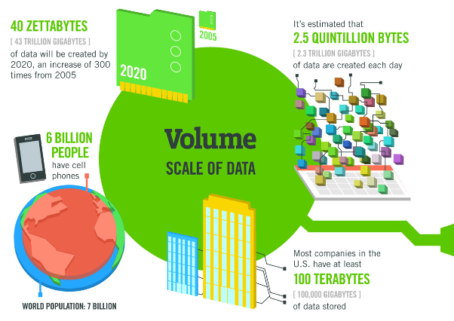
The 3V’s of Big Data
Today it would take a person approximately 181 million years to download all the data from the internet. (Source: Physics.org)
In 2012, only 0.5% of all data was analyzed. (Source: The Guardian)
By 2020, every person will generate 1.7 megabytes in just a second. (Source: Domo)
Source: https://techjury.net/stats-about/big-data-statistics/

Slide 5
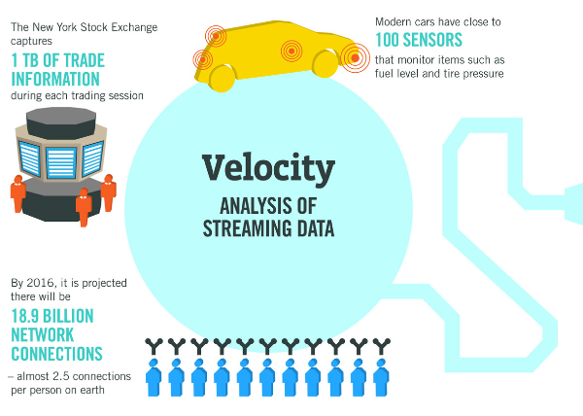
The 3V’s of Big Data
90% of all data has been created in the last two years. (Source: IBM)
Twitter users send nearly half a million tweets every minute. (Source: Domo)
Source: https://techjury.net/stats-about/big-data-statistics/

Slide 6
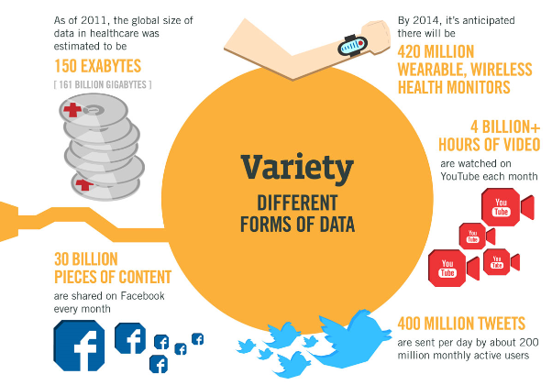
The 3V’s of Big Data
30 billion pieces of content are shared on Facebook every month. (Source: techjury.org)
By 2014, it’s anticipated there will be 420 million wearable, wireless health monitors. (Source: The Guardian)
By 2020, every person will generate 1.7 megabytes in just a second. (Source: Domo)
Source: https://techjury.net/stats-about/big-data-statistics/

Slide 7
DIKW Hierarchy
WISDOM
KNOWLEDGE
INFORMATION
DATA
APPLIED
understanding, integrated, actionable
RAW
signals, know nothing
MEANING
useful, organized, structured
CONTEXT
contextual, synthesized, learning
Source: Rowley, J. (2007). The wisdom hierarchy representations of the DIKW hierarchy. Journal of information science, 33(2), 163-180.

Slide 8

STRUCTURED DATA vs UNSTRUCTERED DATA
%20
structured data
unstructured data
PDFS
WORD DOCUMENTS
%80
SPREADSHEETS
PRESENTATIONS
SOCIAL MEDIA POSTS
BOOKS

Slide 9
Data Preprocessing
Although data increases exponentially, clean data does not increase at the same rate.
Why Is Data Preprocessing Important?
No quality data, no quality mining results!
Garbage in garbage out!
Data extraction, cleaning, and transformation comprises the majority of the work of building a data warehouse.
Why data processing important?
Data in the real world is dirty

Slide 10

CRISP-DM
Cross-industry standard process for data mining, known as CRISP-DM, is an open standard process model that describes common approaches used by data mining experts. CRISP-DM breaks the process of data mining into six major phases.
The sequence of the phases is not strict and moving back and forth between different phases as it is always required. The arrows in the process diagram indicate the most important and frequent dependencies between phases. The outer circle in the diagram symbolizes the cyclic nature of data mining itself. A data mining process continues after a solution has been deployed. The lessons learned during the process can trigger new, often more focused business questions, and subsequent data mining processes will benefit from the experiences of previous ones.
Source: Wikipedia

Slide 11
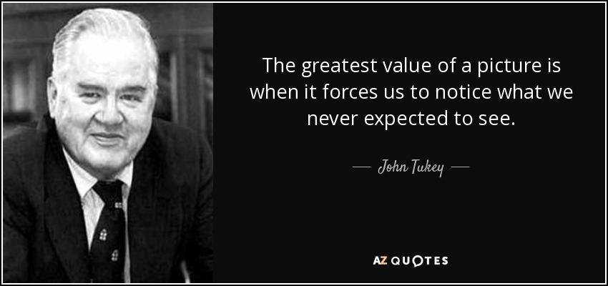
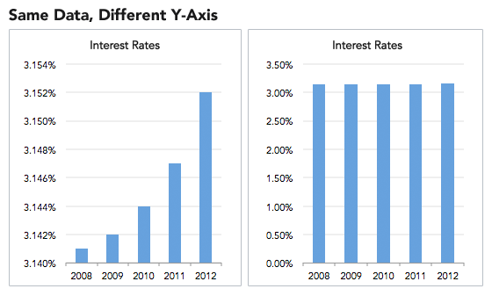
Visualization
Visualization is the conversion of data into a visual or tabular format.
Scale Distortions
Some of good examples
https://www.gapminder.org/tools/#$chart-type=bubbles

Slide 12
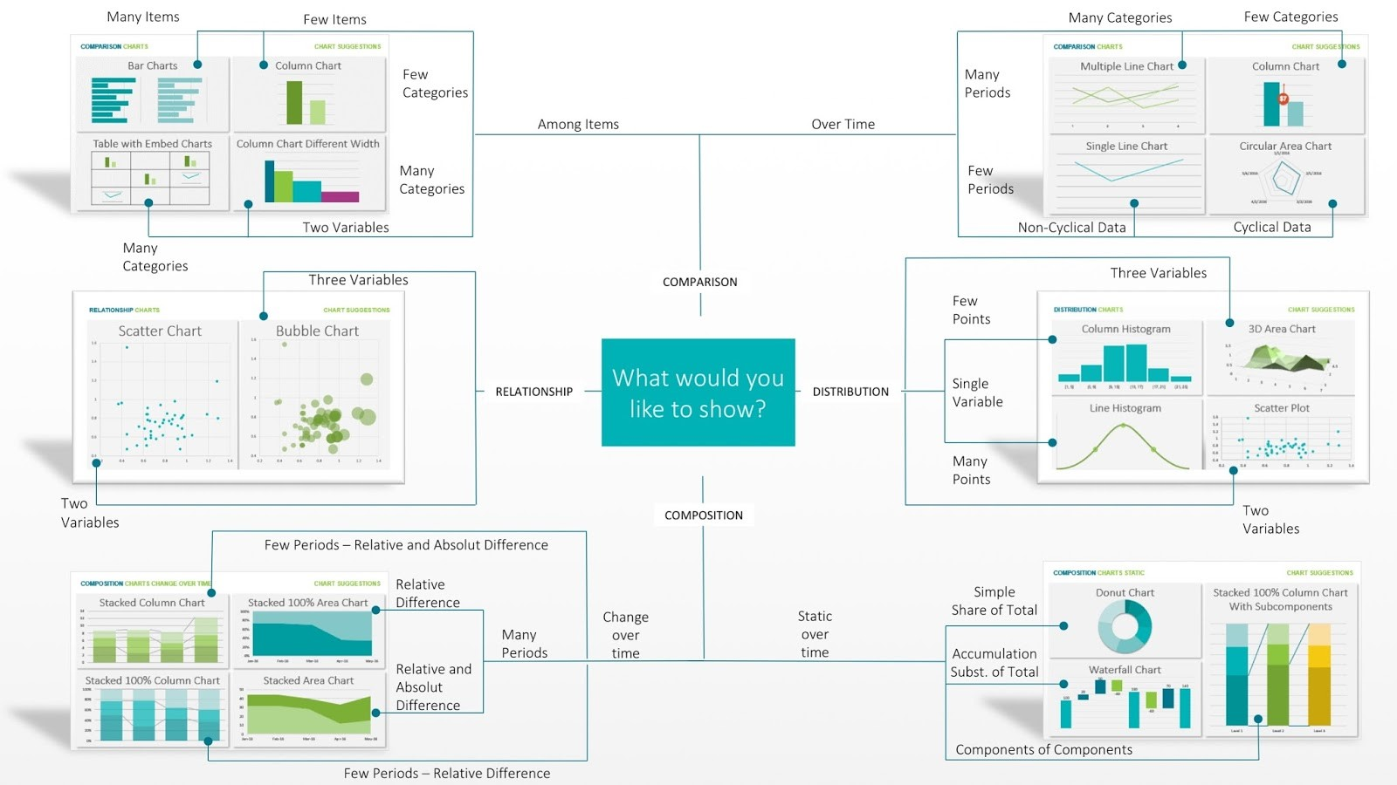
Visualization
Source: https://www.techprevue.com/decision-tree-perfect-visualisation-data/

Slide 13
Model Basics & Machine Learning
What is a model?
Models are typically thought of as an abstraction of (or an approximation to) reality.
Why do we need a model?
Help understand the past, learn from it, and then predict the future
Models allow us to separate data into predictable and unpredictable elements.
What Is Machine Learning?
Machine Learning is the science (and art) of programming computers so they can learn from data.
What Is Data Mining?
Applying ML techniques to dig into large amounts of data can help discover patterns that were not immediately apparent. This is called data mining.

Slide 14



Why Use Machine Learning?
Data
Evaluate
Analyze Errors
Study the Problem
Write Rules
The Machine Learning Approach
The Traditional Approach
Train ML Algorithm
Launch

Slide 15
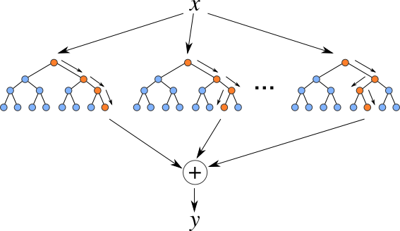

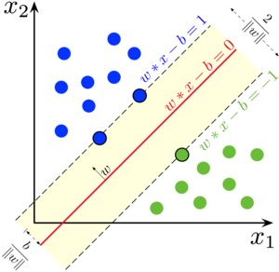
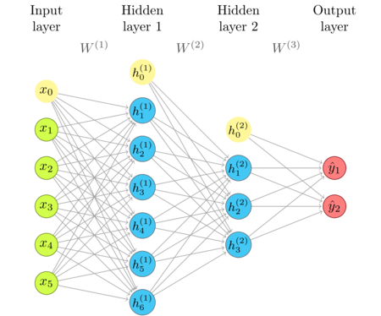
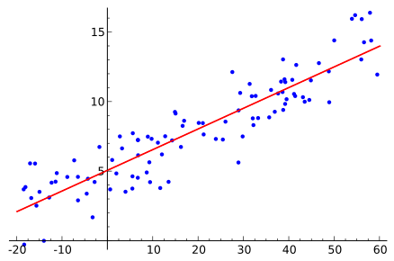

Types of Machine Learning Systems
Machine Learning systems can be classified according to the amount and type of supervision they get during training.
Supervised Learning
In supervised learning, the training data you feed to the algorithm includes the desired solutions, called labels
k-Nearest Neighbors
Linear Regression
Logistic Regression
Support Vector Machines (SVMs)
Decision Trees and Random Forests
Neural networks

Slide 16
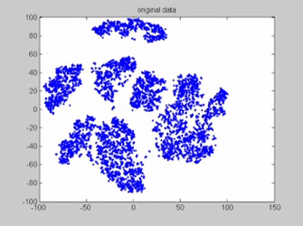
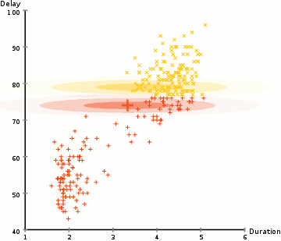

Types of Machine Learning Systems
Unsupervised Learning
In unsupervised learning, the training data is unlabeled. The system tries to learn without a teacher.
Clustering
k-Means
Hierarchical Cluster Analysis (HCA)
Expectation Maximization
Visualization and dimensionality reduction
Principal Component Analysis (PCA)
Kernel PCA
Locally-Linear Embedding (LLE)
t-distributed Stochastic Neighbor Embedding (t-SNE)
Association rule learning
Apriori
Eclat

Slide 17
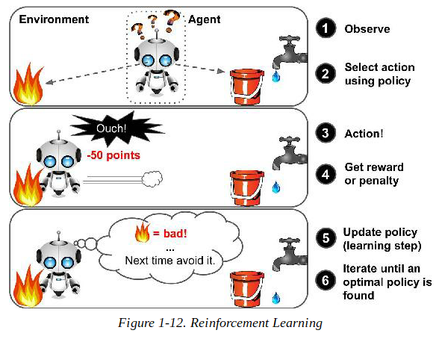
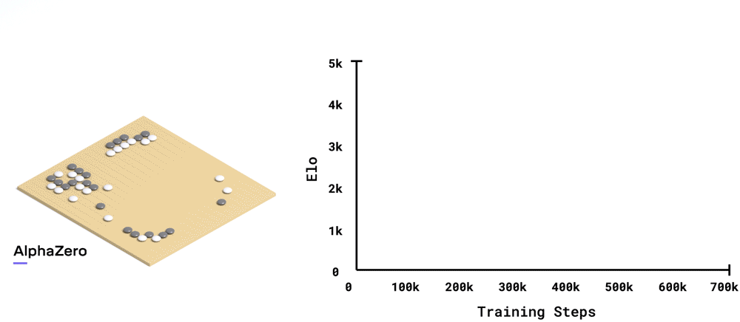
Types of Machine Learning Systems
Reinforcement Learning
The learning system, called an agent in this context, can observe the environment, select and perform actions, and get rewards in return (or penalties in the form of negative rewards, as in figure.
IN CHESS, ALPHAZERO FIRST OUTPERFORMED STOCKFISH AFTER JUST 4 HOURS; IN SHOGI, ALPHAZERO FIRST OUTPERFORMED ELMO AFTER 2 HOURS; AND IN GO, ALPHAZERO FIRST OUTPERFORMED THE VERSION OF ALPHAGO THAT BEAT THE LEGENDARY PLAYER LEE SEDOL IN 2016 AFTER 30 HOURS.
Source: https://deepmind.com/blog/article/alphazero-shedding-new-light-grand-games-chess-shogi-and-go

Slide 18

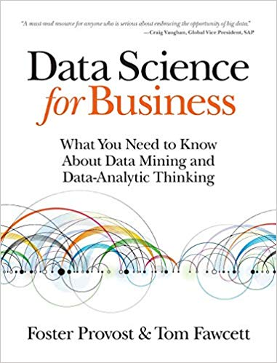
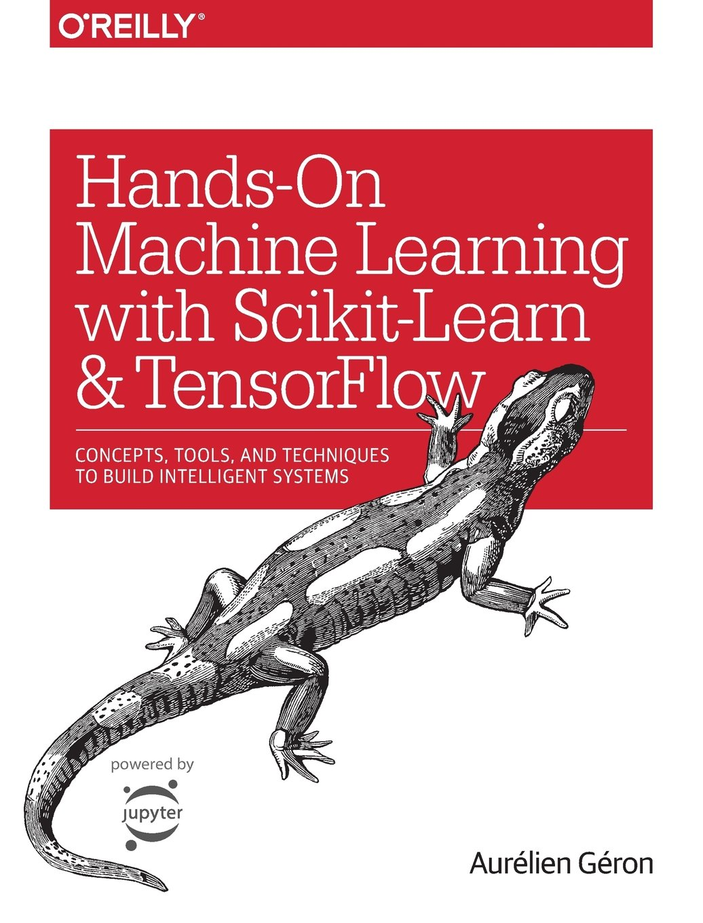
Further Readings
Books:
50 Soruda Yapay Zeka – Cem Say
Introduction to Machine Learning – Ethem Alpaydın
Deep Learning - Ian Goodfellow, Yoshua Bengio, Aaron Courville
Deep Learning with Python - François Chollet
Hello World: Being Human in the Age of Algorithms – Hannah Fry
Hands-On Machine Learning with Scikit-Learn and TensorFlow… – Aurelien Geron
Data Science for Business - Foster Provost, Tom Fawcett
Practical Statistics for Data Scientists – Peter Bruce
Python for Data Analysis – Wes McKinney
Artificial Intelligence Past and Future – Nils J. Nilsson
Web:
https://datatau.net/
https://www.kaggle.com/
https://towardsdatascience.com/
https://www.coursera.org/
http://colah.github.io/
https://www.datacamp.com/

Slide 19
mehmetali.varol@linktera.com.tr
Vogue Business Center, Küçükbakkalköy mah. Merdivenköy Yolu Cad. Rüya sok. No.12, Kat 18 34746 İstanbul-Ataşehir

